Slide 1


Slide 2
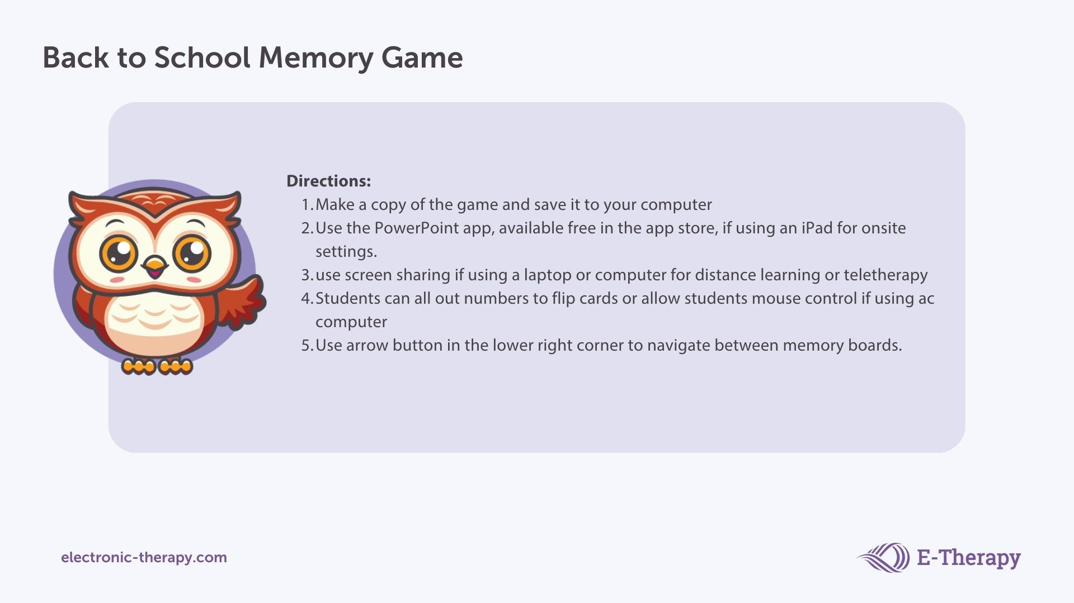

Slide 3





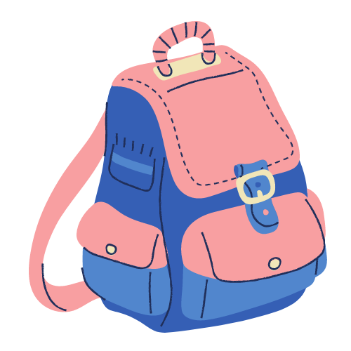
1
2
3
4
5
6
7
8
9
10
Next

Slide 4





1
2
3
4
5
6
7
8
9
10
Next

Slide 5

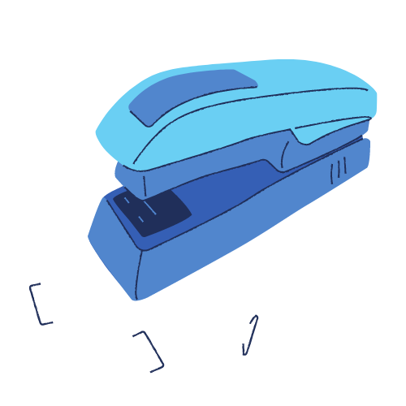
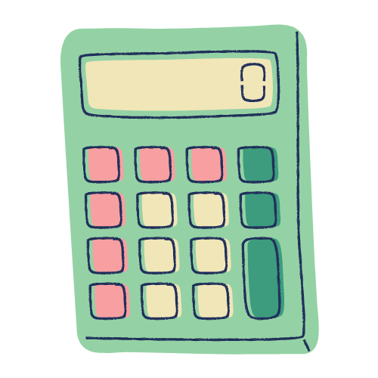

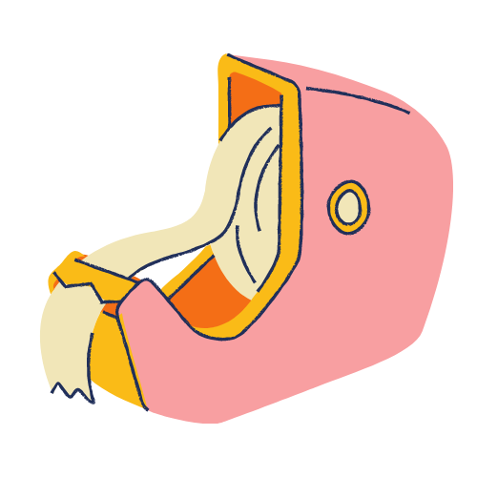
1
2
3
4
5
6
7
8
9
10
Next

Slide 6


