Slide 1


Slide 2
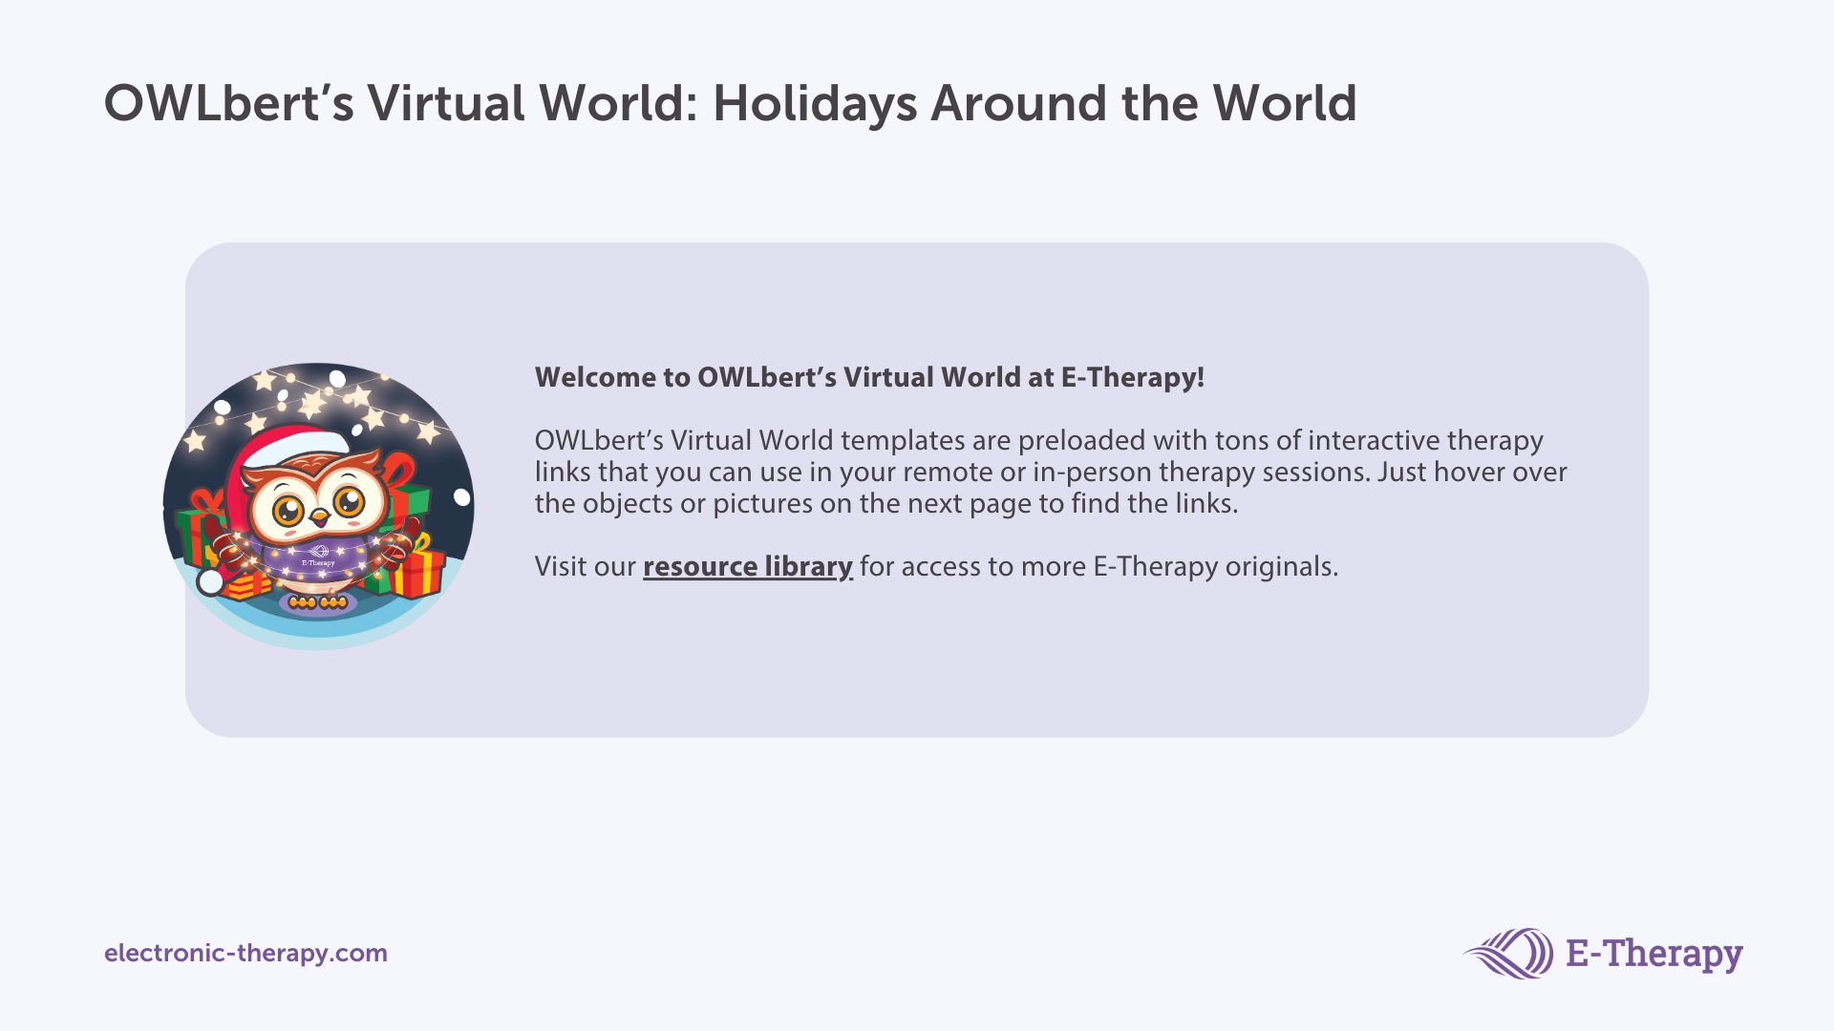

Slide 3






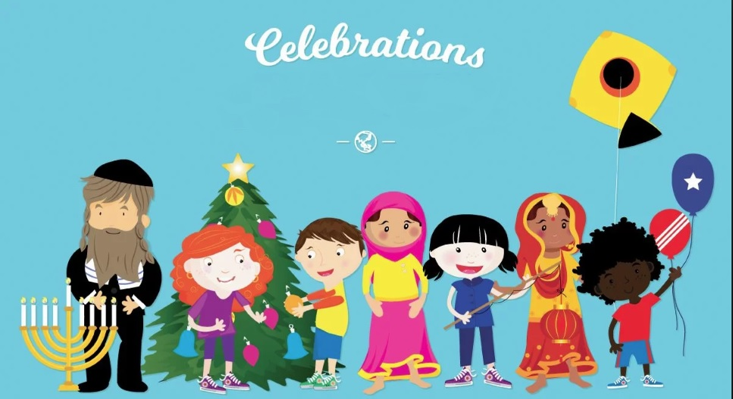
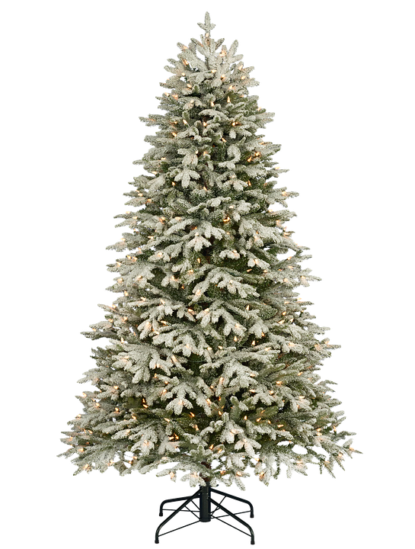


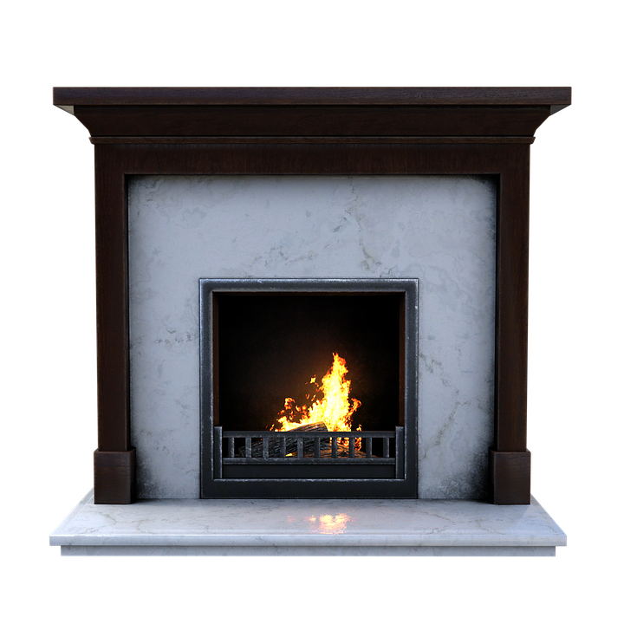





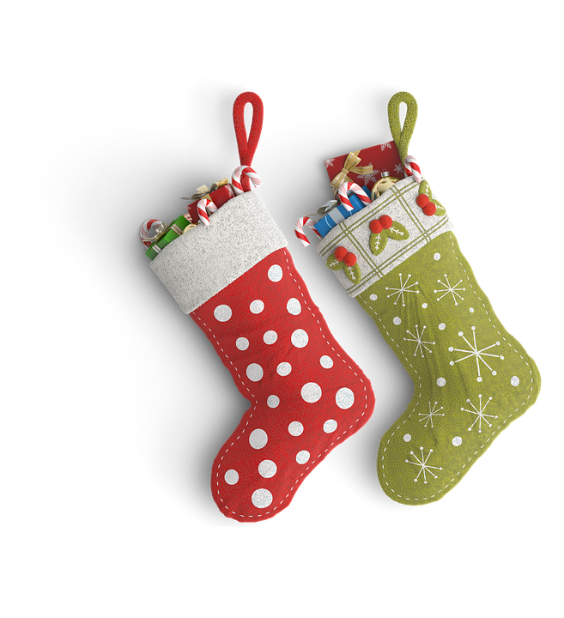


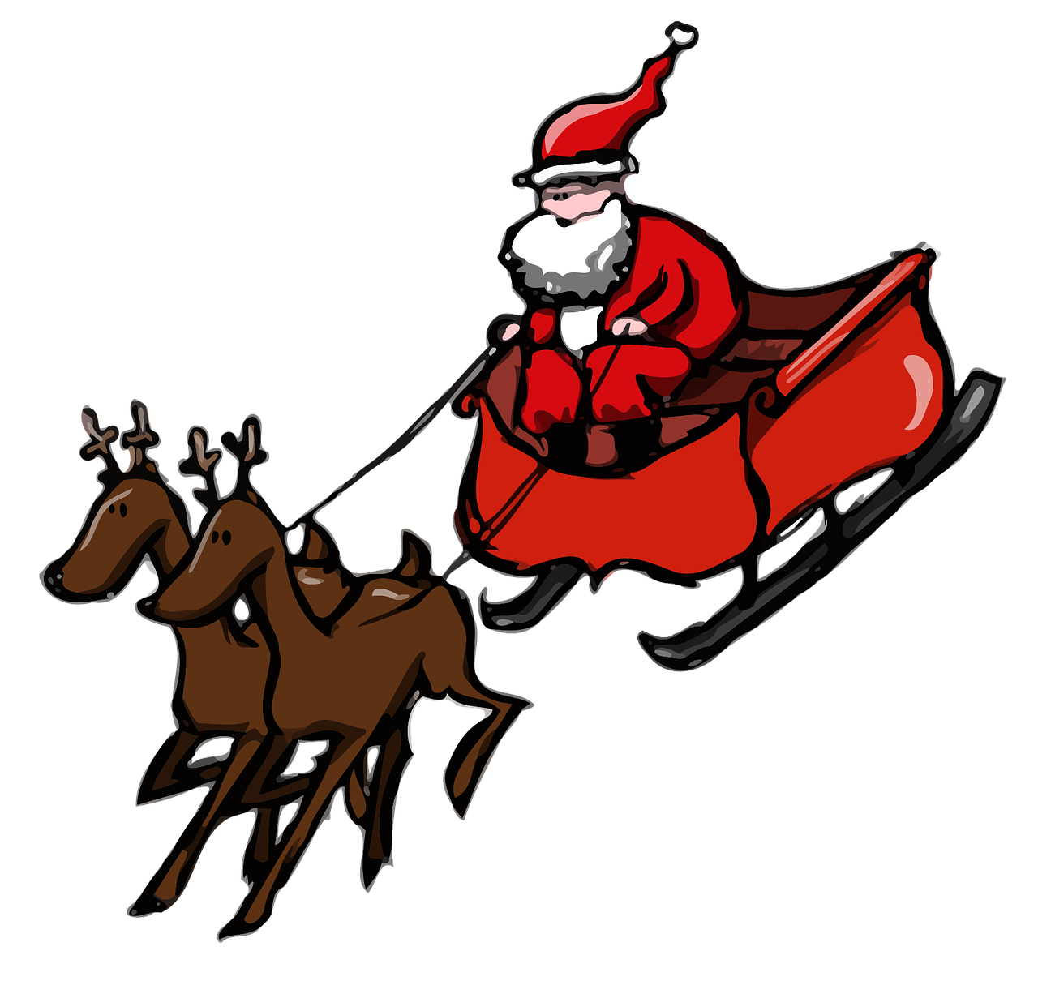
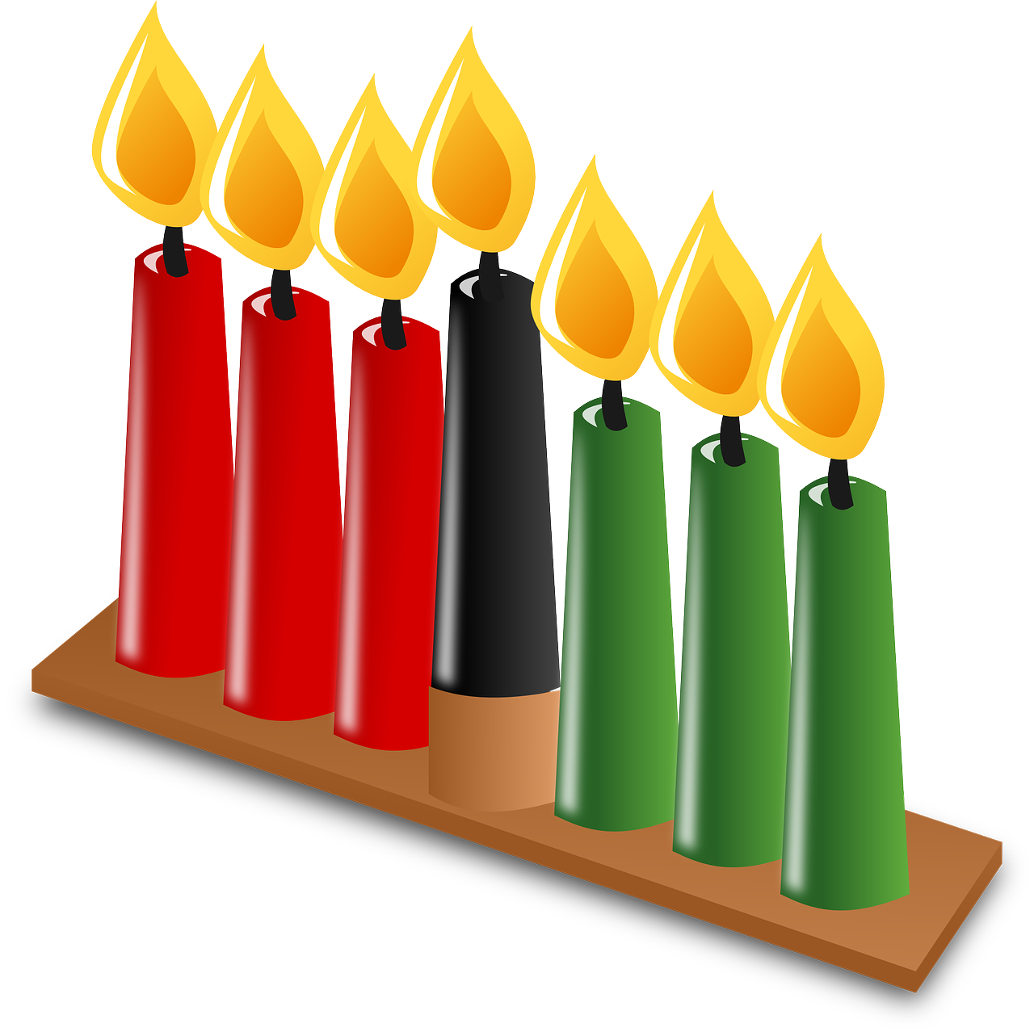
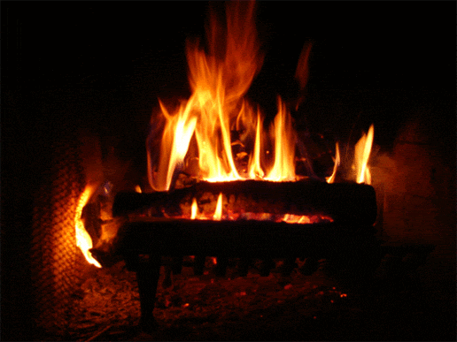


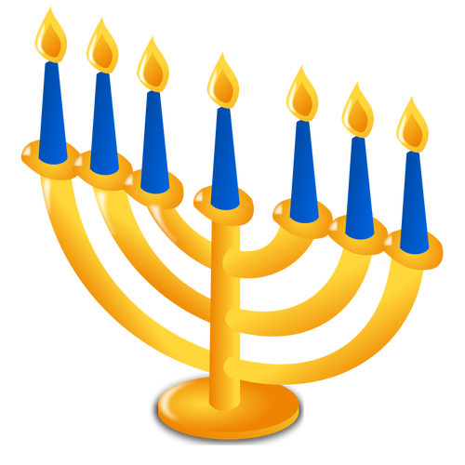


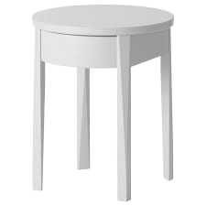
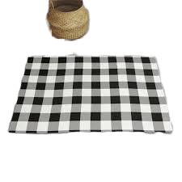


Notes:
Winter Solstice- Dec 21 (sun) St Lucia Day- Dec 13 (gnome in box) Kwanzaa- Dec 26-Jan 1 (candles)
Holidays Around the World (fireplace pic) Lights Around the World (garland lights) Tree Decorator (tree)
New Year’s Eve- Dec 31(2022) Hanukkah- Dec 10-18 (x2 dreidel and menorah) St Nicholas Day- Dec 6 (St. Nick book)
Hot Chocolate (cocoa) Gingerbread (gingerbread book) Christmas- Dec 25 (Santa and sleigh)
Polar Express (train) Boxing Day- Dec 26 (striped box)

Slide 4


