Slide 1
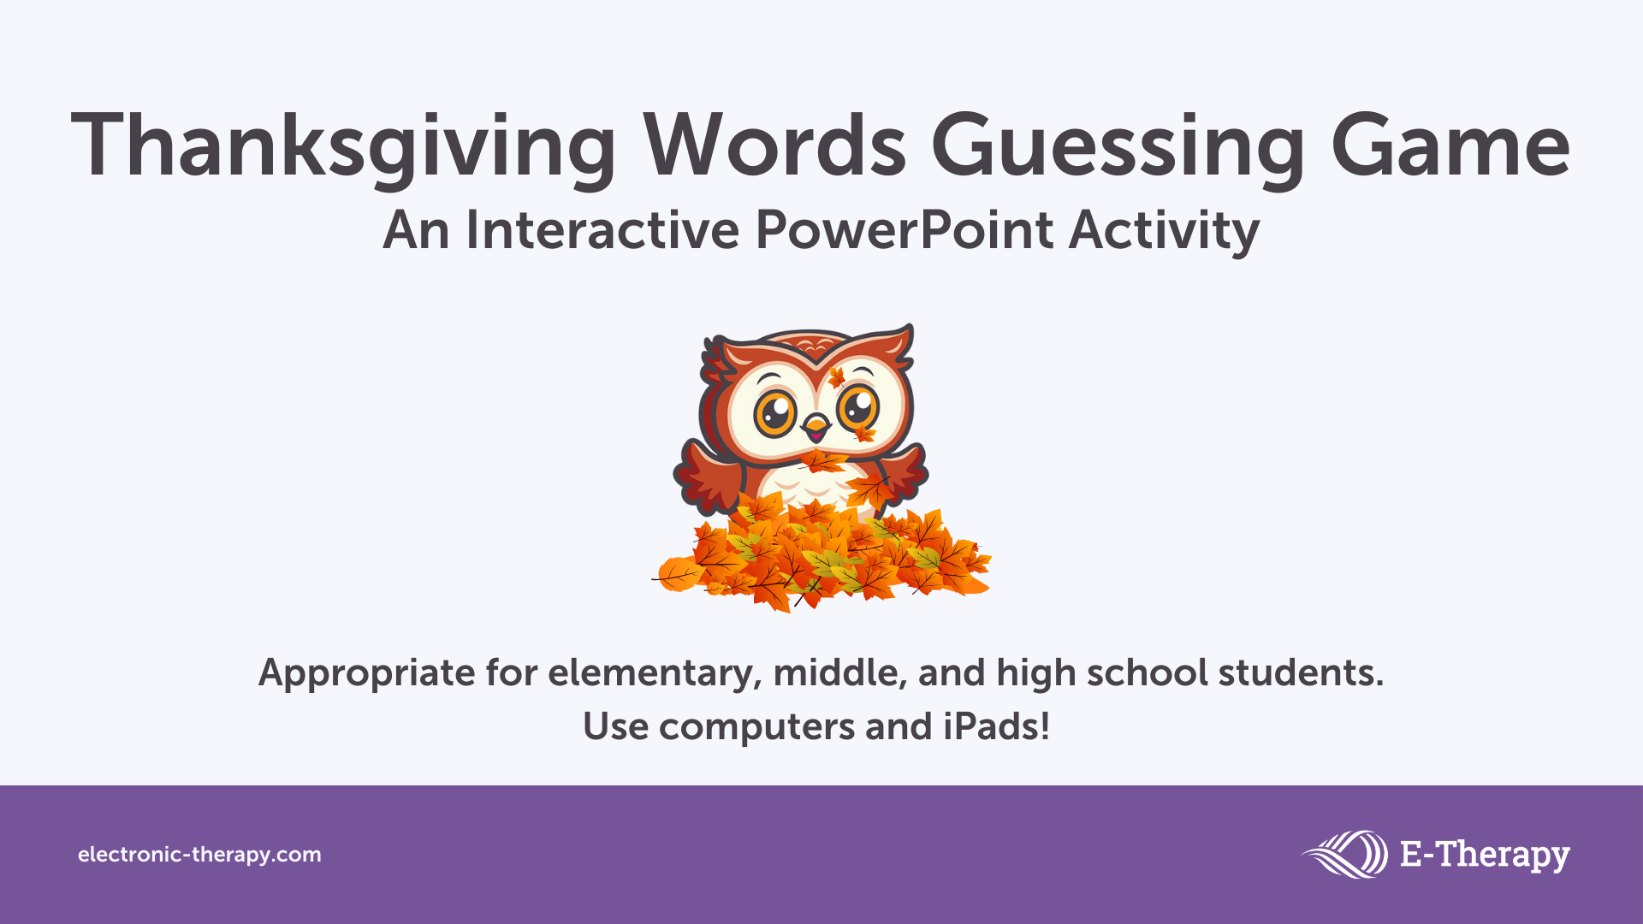

Slide 2
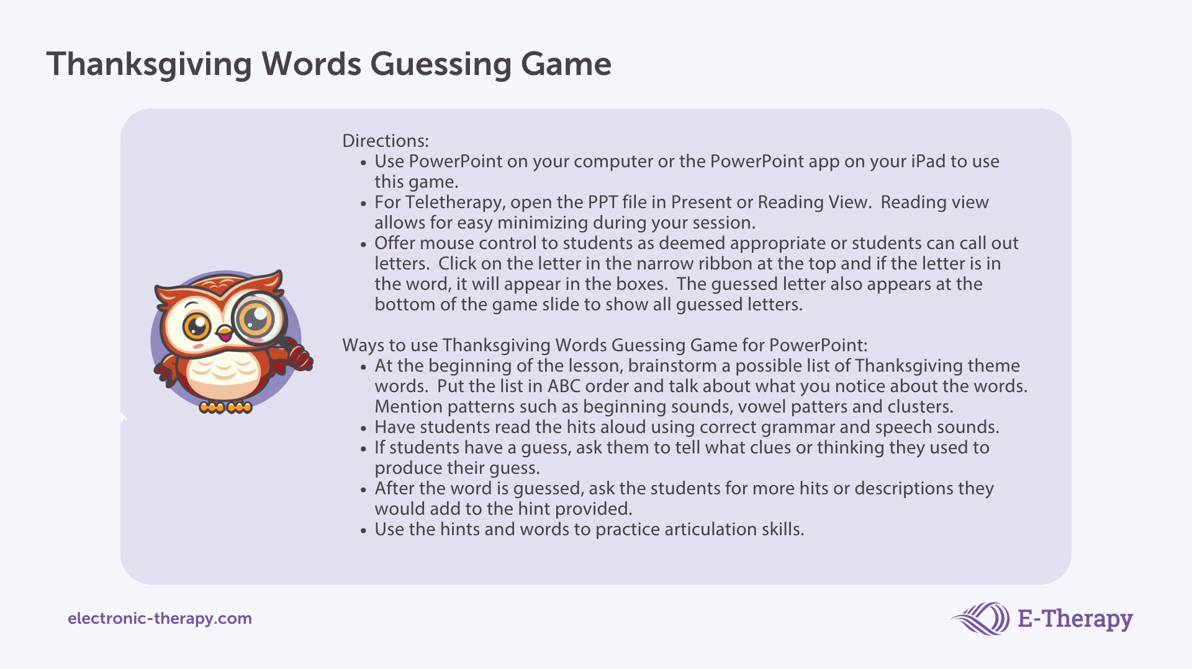
Notes:
DONE - Aleah

Slide 3


Choose letters to guess the Thanksgiving words!
a
b
c
d
e
f
g
h
i
j
k
l
m
n
o
p
q
r
s
t
u
v
w
x
y
z
t
u
r
k
e
y
Click!
Hint
I have feathers and I gobble.
a
a
a
a
a
a
a
b
b
b
b
b
b
c
c
c
c
c
c
d
d
d
d
d
d
e
e
e
e
e
e
e
f
f
f
f
f
f
g
g
g
g
g
h
h
h
h
h
h
i
i
i
i
i
i
i
i
i
j
j
j
j
j
k
k
k
k
k
l
l
l
l
l
l
l
l
m
m
m
m
m
m
m
m
n
n
n
n
n
n
n
n
o
o
o
o
o
o
o
o
p
p
p
p
p
p
p
p
q
q
q
q
r
r
r
r
r
r
r
s
s
s
s
s
s
s
s
s
t
t
t
t
t
t
t
t
u
u
u
u
u
u
u
v
v
v
v
v
w
w
w
w
w
w
w
x
x
x
y
y
y
y
y
z
z
z
z
z
Back
Next

Slide 4
Choose letters to guess the Thanksgiving words!
a
b
c
d
e
f
g
h
i
j
k
l
m
n
o
p
q
r
s
t
u
v
w
x
y
z
c
r
a
n
b
e
r
r
y
s
a
u
c
e
Click!
Hint
I look like red Jell-O and sometimes I come in can.
a
a
a
a
a
b
b
b
b
b
c
c
c
c
d
d
d
d
d
d
e
e
e
e
e
e
f
f
f
f
f
f
g
g
g
g
g
h
h
h
h
h
h
i
i
i
i
i
i
i
i
i
j
j
j
j
j
k
k
k
k
k
k
l
l
l
l
l
l
l
l
m
m
m
m
m
m
m
m
n
n
n
n
n
n
n
o
o
o
o
o
o
o
o
p
p
p
p
p
p
p
p
q
q
q
q
r
r
r
r
r
s
s
s
s
s
s
s
s
t
t
t
t
t
t
t
t
t
u
u
u
u
u
u
u
v
v
v
v
v
w
w
w
w
w
w
w
x
x
x
y
y
y
y
y
z
z
z
z
z
Back
Next

Slide 5
Choose letters to guess the Thanksgiving words!
a
b
c
d
e
f
g
h
i
j
k
l
m
n
o
p
q
r
s
t
u
v
w
x
y
z
f
a
m
i
l
y
Click!
Hint
A group of people.
a
a
a
a
a
a
b
b
b
b
b
b
c
c
c
c
c
c
d
d
d
d
d
d
e
e
e
e
e
e
e
e
f
f
f
f
f
g
g
g
g
g
h
h
h
h
h
h
i
i
i
i
i
i
i
i
j
j
j
j
j
k
k
k
k
k
k
l
l
l
l
l
l
l
m
m
m
m
m
m
m
n
n
n
n
n
n
n
n
o
o
o
o
o
o
o
o
p
p
p
p
p
p
p
p
q
q
q
q
r
r
r
r
r
r
r
r
s
s
s
s
s
s
s
s
s
t
t
t
t
t
t
t
t
t
u
u
u
u
u
u
u
u
v
v
v
v
v
w
w
w
w
w
w
w
x
x
x
y
y
y
y
y
z
z
z
z
z
Back
Next

Slide 6
Choose letters to guess the Thanksgiving words!
a
b
c
d
e
f
g
h
i
j
k
l
m
n
o
p
q
r
s
t
u
v
w
x
y
z
p
u
m
p
k
i
n
p
i
e
Click!
Hint
I am a dessert.
a
a
a
a
a
a
a
b
b
b
b
b
b
c
c
c
c
c
c
d
d
d
d
d
d
e
e
e
e
e
e
e
f
f
f
f
f
f
g
g
g
g
g
h
h
h
h
h
h
i
i
i
i
i
i
i
j
j
j
j
j
k
k
k
k
k
l
l
l
l
l
l
l
l
m
m
m
m
m
m
m
n
n
n
n
n
n
n
o
o
o
o
o
o
o
o
p
p
p
p
p
q
q
q
q
r
r
r
r
r
r
r
r
s
s
s
s
s
s
s
s
s
t
t
t
t
t
t
t
t
t
u
u
u
u
u
u
u
v
v
v
v
v
w
w
w
w
w
w
w
x
x
x
y
y
y
y
y
y
z
z
z
z
z
Back
Next

Slide 7
Choose letters to guess the Thanksgiving words!
a
b
c
d
e
f
g
h
i
j
k
l
m
n
o
p
q
r
s
t
u
v
w
x
y
z
p
a
r
a
d
e
s
Click!
Hint
I have floats and marching bands.
a
a
a
a
a
b
b
b
b
b
b
c
c
c
c
c
c
d
d
d
d
d
e
e
e
e
e
e
e
f
f
f
f
f
f
g
g
g
g
g
h
h
h
h
h
h
i
i
i
i
i
i
i
i
i
j
j
j
j
j
k
k
k
k
k
k
l
l
l
l
l
l
l
l
m
m
m
m
m
m
m
m
n
n
n
n
n
n
n
n
o
o
o
o
o
o
o
o
p
p
p
p
p
p
p
q
q
q
q
r
r
r
r
r
r
r
s
s
s
s
s
s
s
s
t
t
t
t
t
t
t
t
t
u
u
u
u
u
u
u
u
v
v
v
v
v
w
w
w
w
w
w
w
x
x
x
y
y
y
y
y
y
z
z
z
z
z
Back
Next

Slide 8
Choose letters to guess the Thanksgiving words!
a
b
c
d
e
f
g
h
i
j
k
l
m
n
o
p
q
r
s
t
u
v
w
x
y
z
g
r
a
v
y
Click!
Hint
Some people pour me on top of mashed potatoes.
a
a
a
a
a
a
b
b
b
b
b
b
c
c
c
c
c
c
d
d
d
d
d
d
e
e
e
e
e
e
e
e
f
f
f
f
f
f
g
g
g
g
h
h
h
h
h
h
i
i
i
i
i
i
i
i
i
j
j
j
j
j
k
k
k
k
k
k
l
l
l
l
l
l
l
l
m
m
m
m
m
m
m
m
n
n
n
n
n
n
n
n
o
o
o
o
o
o
o
o
p
p
p
p
p
p
p
p
q
q
q
q
r
r
r
r
r
r
r
s
s
s
s
s
s
s
s
s
t
t
t
t
t
t
t
t
t
u
u
u
u
u
u
u
u
v
v
v
v
w
w
w
w
w
w
w
x
x
x
y
y
y
y
y
z
z
z
z
z
Back
Next

Slide 9
Choose letters to guess the Thanksgiving words!
a
b
c
d
e
f
g
h
i
j
k
l
m
n
o
p
q
r
s
t
u
v
w
x
y
z
s
t
u
f
f
i
n
g
Click!
Hint
I am made with spices and pieces of bread.
a
a
a
a
a
a
a
b
b
b
b
b
b
c
c
c
c
c
c
d
d
d
d
d
d
e
e
e
e
e
e
e
e
f
f
f
f
g
g
g
g
h
h
h
h
h
h
i
i
i
i
i
i
i
i
j
j
j
j
j
k
k
k
k
k
k
l
l
l
l
l
l
l
l
m
m
m
m
m
m
m
m
n
n
n
n
n
n
n
o
o
o
o
o
o
o
o
p
p
p
p
p
p
p
p
q
q
q
q
r
r
r
r
r
r
r
r
s
s
s
s
s
s
s
s
t
t
t
t
t
t
t
t
u
u
u
u
u
u
u
v
v
v
v
v
w
w
w
w
w
w
w
x
x
x
y
y
y
y
y
y
z
z
z
z
z
Back
Next

Slide 10
Choose letters to guess the Thanksgiving words!
a
b
c
d
e
f
g
h
i
j
k
l
m
n
o
p
q
r
s
t
u
v
w
x
y
z
f
o
o
t
b
a
l
l
Click!
Hint
Some people like to watch their favorite team play this sport.
a
a
a
a
a
a
b
b
b
b
b
c
c
c
c
c
c
d
d
d
d
d
d
e
e
e
e
e
e
e
e
f
f
f
f
f
g
g
g
g
g
h
h
h
h
h
h
i
i
i
i
i
i
i
i
i
j
j
j
j
j
k
k
k
k
k
k
l
l
l
l
l
l
m
m
m
m
m
m
m
m
n
n
n
n
n
n
n
n
o
o
o
o
o
o
p
p
p
p
p
p
p
p
q
q
q
q
r
r
r
r
r
r
r
r
s
s
s
s
s
s
s
s
s
t
t
t
t
t
t
t
t
u
u
u
u
u
u
u
u
v
v
v
v
v
w
w
w
w
w
w
w
x
x
x
y
y
y
y
y
y
z
z
z
z
z
Back
Next

Slide 11
Choose letters to guess the Thanksgiving words!
a
b
c
d
e
f
g
h
i
j
k
l
m
n
o
p
q
r
s
t
u
v
w
x
y
z
m
a
s
h
e
d
p
o
t
a
t
o
e
s
Click!
Hint
Some people put butter or gravy on top of me.
a
a
a
a
a
b
b
b
b
b
b
c
c
c
c
c
c
d
d
d
d
d
e
e
e
e
e
e
f
f
f
f
f
f
g
g
g
g
g
h
h
h
h
h
i
i
i
i
i
i
i
i
i
j
j
j
j
j
k
k
k
k
k
k
l
l
l
l
l
l
l
l
m
m
m
m
m
m
m
n
n
n
n
n
n
n
n
o
o
o
o
o
o
p
p
p
p
p
p
p
q
q
q
q
r
r
r
r
r
r
r
r
s
s
s
s
s
s
s
t
t
t
t
t
t
t
u
u
u
u
u
u
u
u
v
v
v
v
v
w
w
w
w
w
w
w
x
x
x
y
y
y
y
y
y
z
z
z
z
z
Back
Next

Slide 12
Choose letters to guess the Thanksgiving words!
a
b
c
d
e
f
g
h
i
j
k
l
m
n
o
p
q
r
s
t
u
v
w
x
y
z
t
h
a
n
k
f
u
l
Click!
Hint
A feeling or emotion.
a
a
a
a
a
a
b
b
b
b
b
b
c
c
c
c
c
c
d
d
d
d
d
d
e
e
e
e
e
e
e
e
f
f
f
f
f
g
g
g
g
g
h
h
h
h
h
i
i
i
i
i
i
i
i
i
j
j
j
j
j
k
k
k
k
k
l
l
l
l
l
l
l
m
m
m
m
m
m
m
m
n
n
n
n
n
n
n
o
o
o
o
o
o
o
o
p
p
p
p
p
p
p
p
q
q
q
q
r
r
r
r
r
r
r
r
s
s
s
s
s
s
s
s
s
t
t
t
t
t
t
t
t
u
u
u
u
u
u
u
v
v
v
v
v
w
w
w
w
w
w
w
x
x
x
y
y
y
y
y
y
z
z
z
z
z
Back
Next

Slide 13
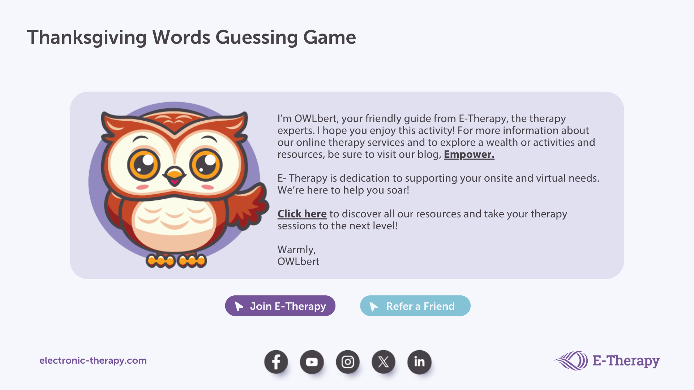
Notes:
DONE - Aleah

