Slide 1

electronic-therapy.com

Slide 2
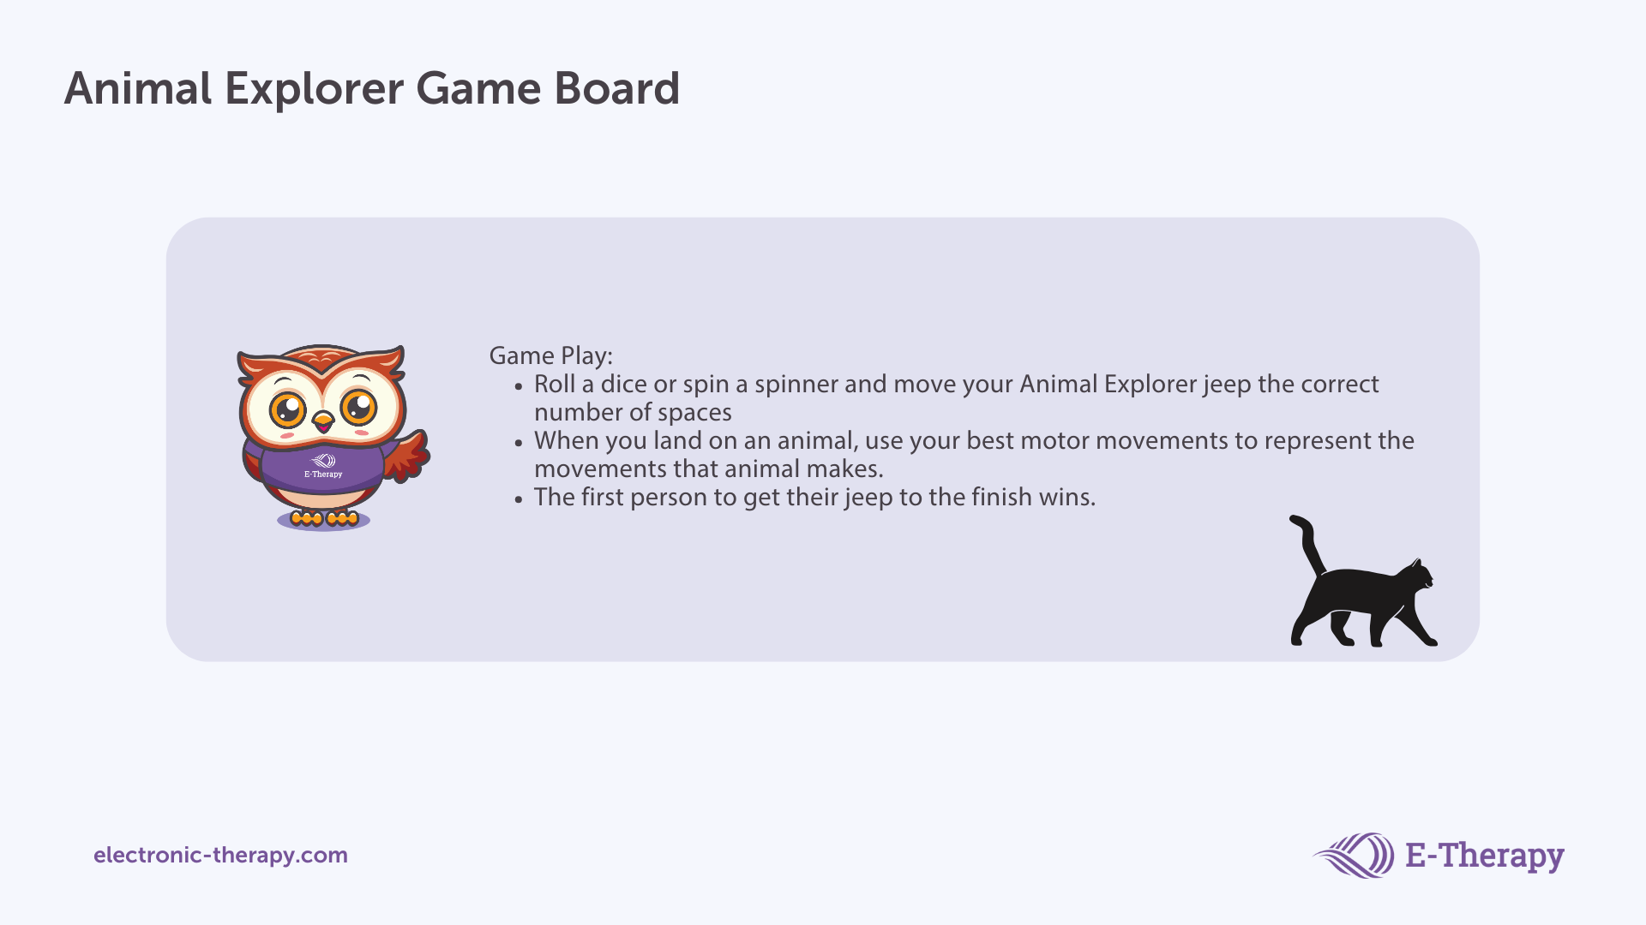

Slide 3






Slide 4


