Slide 1


Slide 2
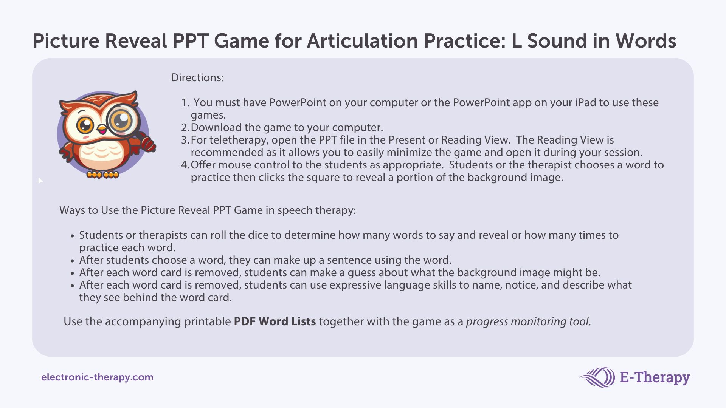

Slide 3
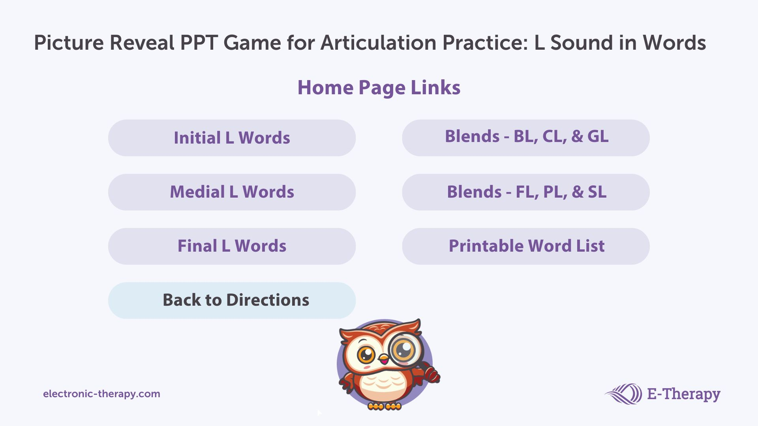

Slide 4
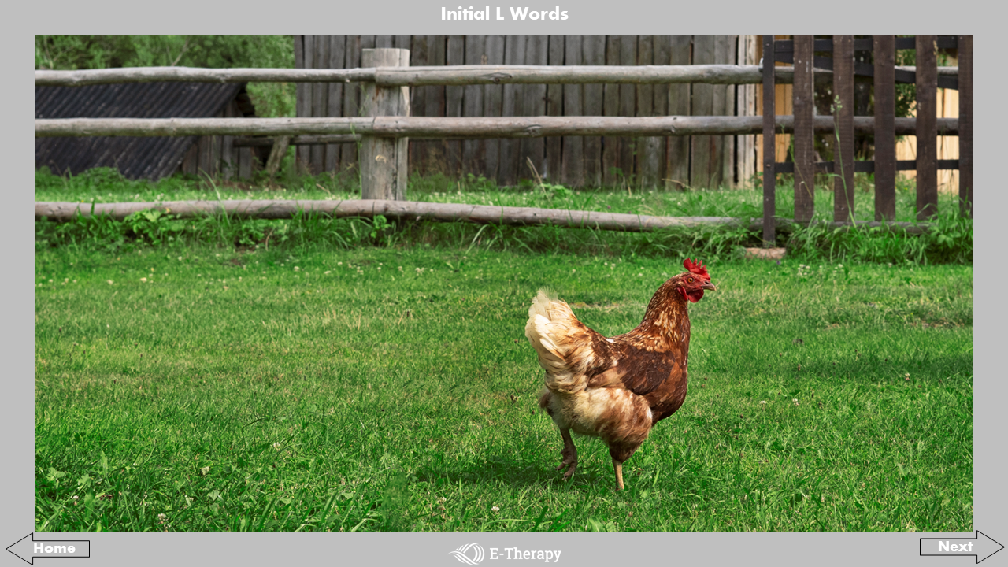
leaf
long
late
log
loss
lift
litter
lunch
lamp
light
lap
leap
little
last
latch
Luke
laugh
lock
letter
lamb
limb
lap
Liz
loose
leak
look
lucky
lead
lid
lad
link
loot
list
lips
land
limp
lick
ladder
lump
lime

Slide 5
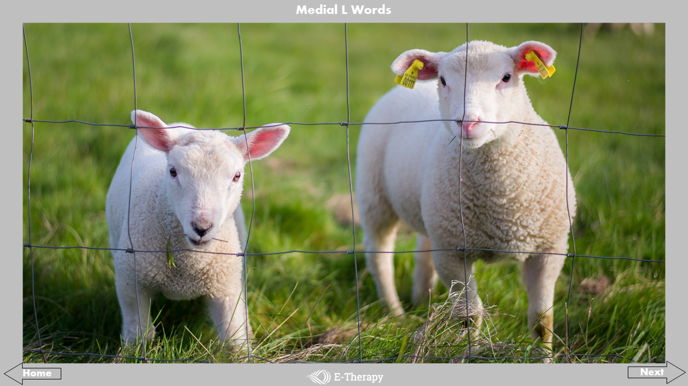
belly
police
family
dollar
envelope
fellow
alive
July
silly
salad
wallpaper
shoelace
believe
Jell-O
colors
belong
sailor
pillow
walrus
elbow
below
Mylie
hello
ceiling
ballroom
wallet
willow
elephant
eyelash
mailbox
olive
celery
alarm
calendar
pilot
violin
mellow
bowling
balloon
Alaska

Slide 6
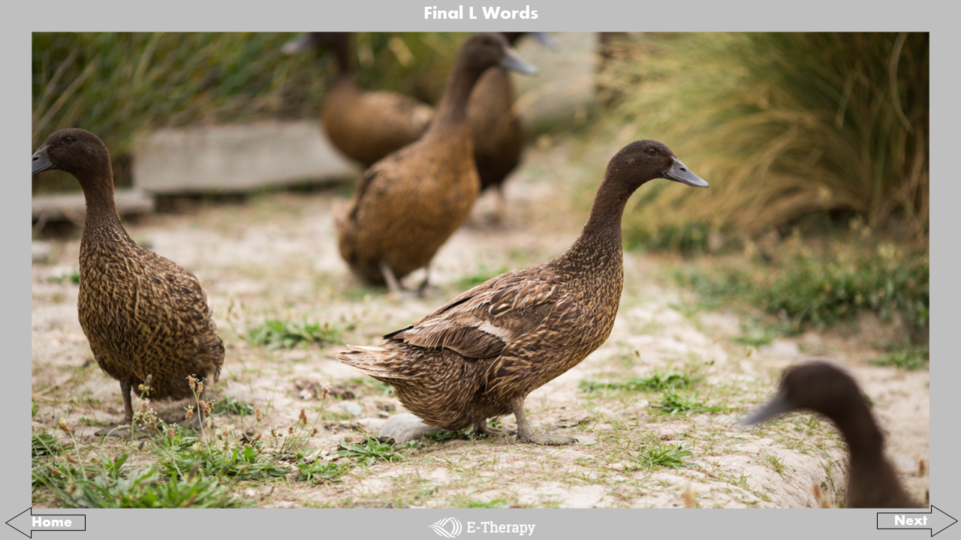
ball
muscle
yell
whale
wheel
meal
smell
fill
mail
fall
tale
owl
hole
cool
fell
feel
nail
shell
heel
hill
wall
tall
steal
April
seal
tail
bowl
pencil
spell
tell
kneel
baseball
pool
call
bell
towel
cell
doll
pill
drill

Slide 7
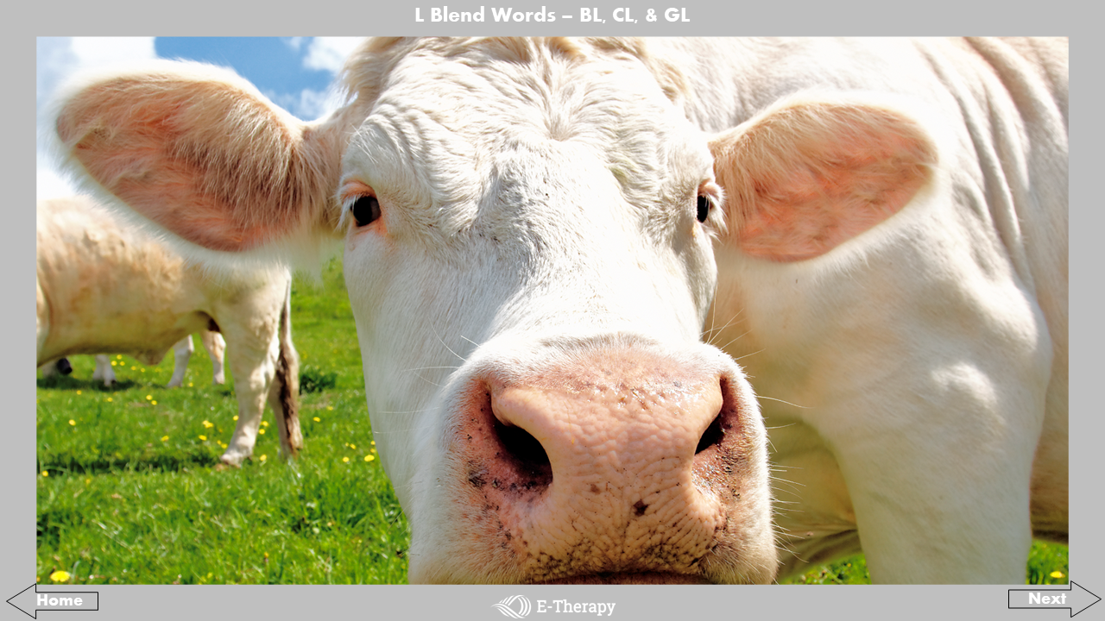
blanket
blush
blister
clap
claw
clumsy
glass
glow
black
blew
blizzard
clock
closet
class
glad
glove
blue
blocks
blossom
cloud
clothes
clean
globe
glue
blink
blow
blind
clam
club
climb
glitter
gloom
blur
blood
bluebird
close
cluck
clever
gloss
gleam

Slide 8
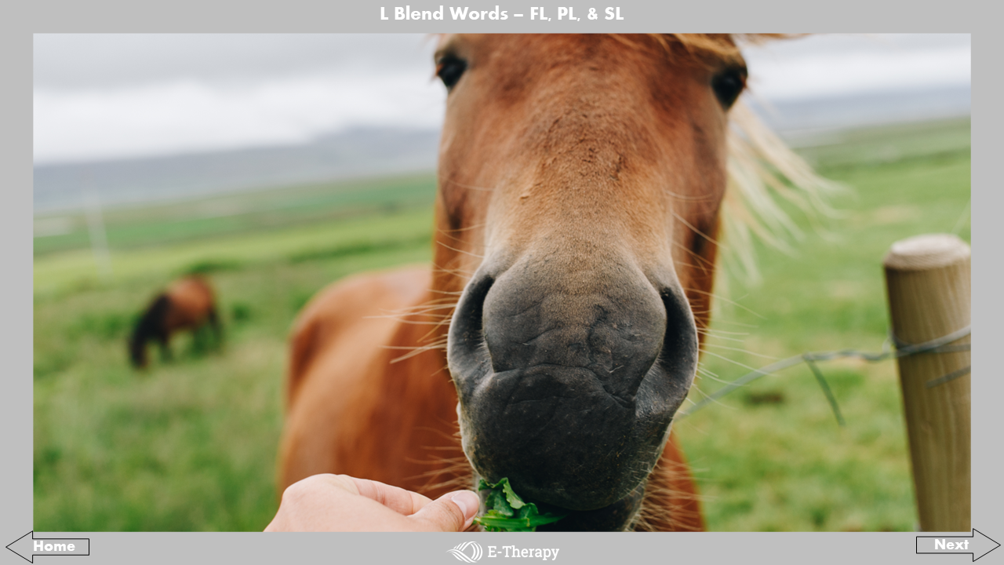
floor
float
floppy
plane
plus
pluck
slide
slow
flower
Florida
fluffy
please
plow
plum
sleep
slug
floss
flute
flying
planet
plastic
plate
slam
slip
fly
flimsy
flicker
play
placemat
plenty
sleeve
sloppy
flat
flavor
flashlight
plant
playful
place
sled
slobber

Slide 9


