Slide 1


Slide 2
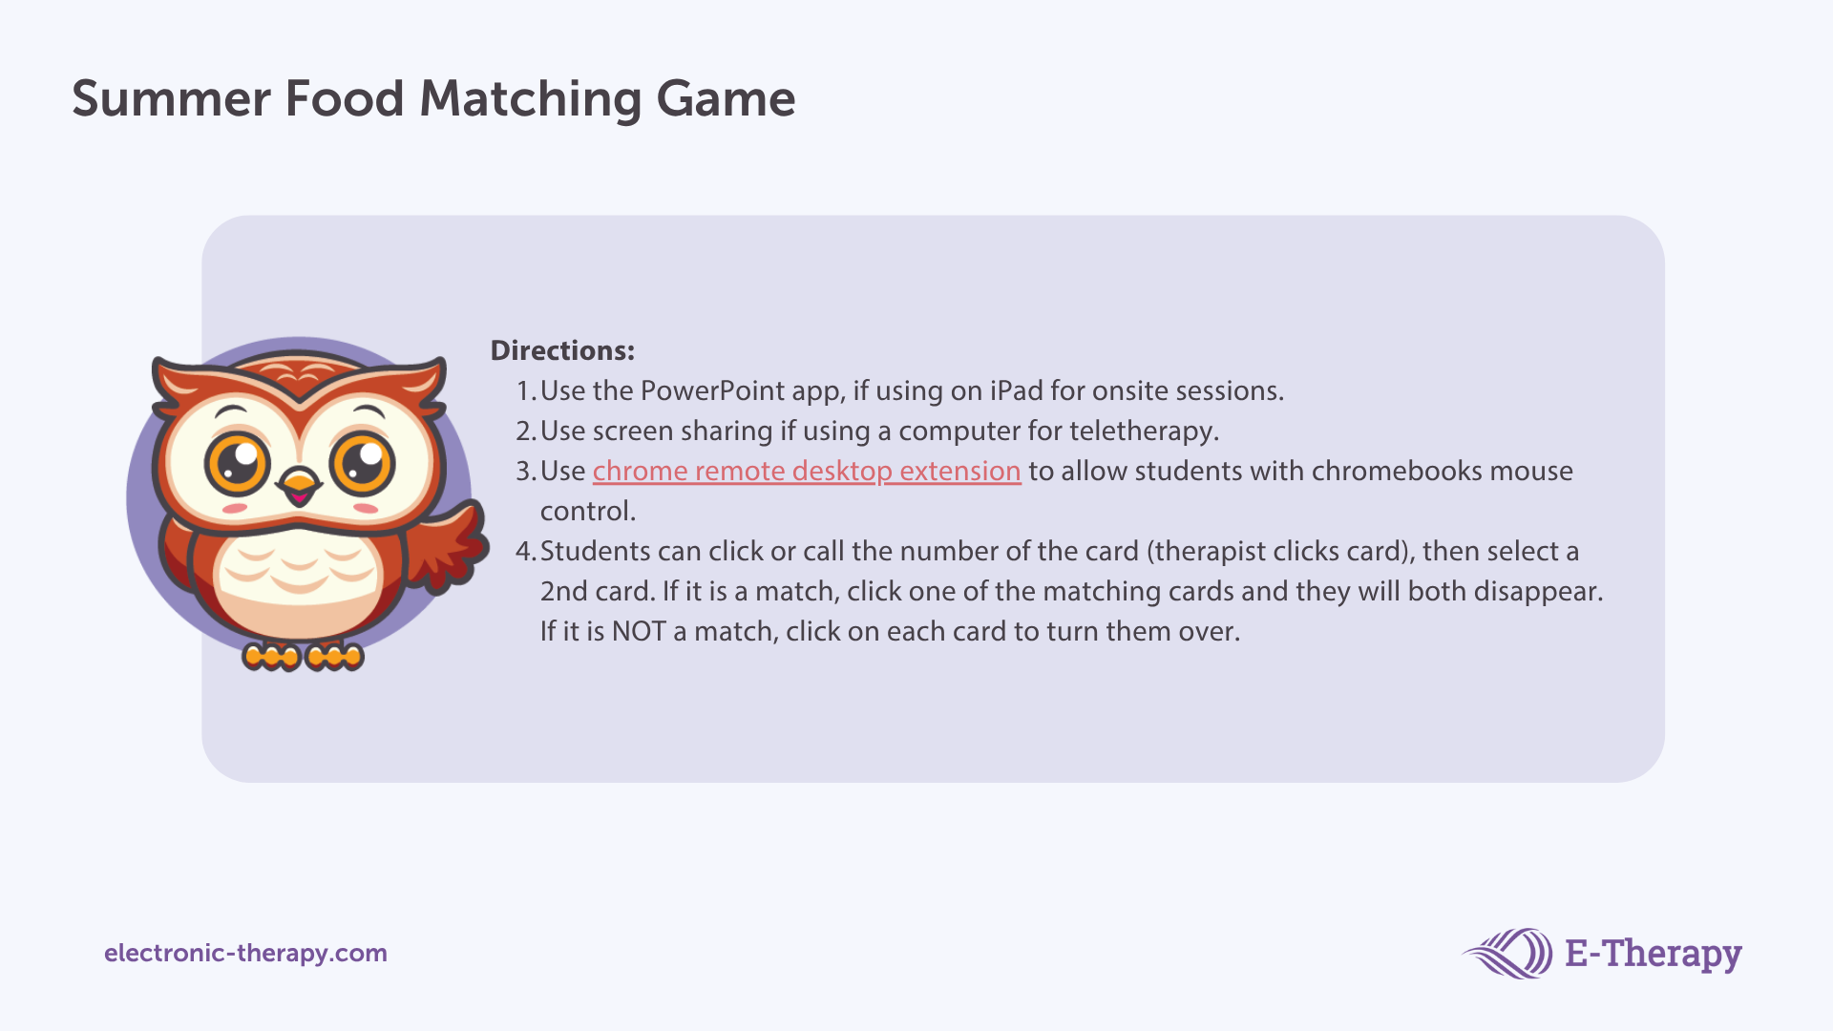
Next

Slide 3










3
1
5
4
2
6
9
7
11
10
8
12
15
13
17
16
14
18

Slide 4


