Slide 1
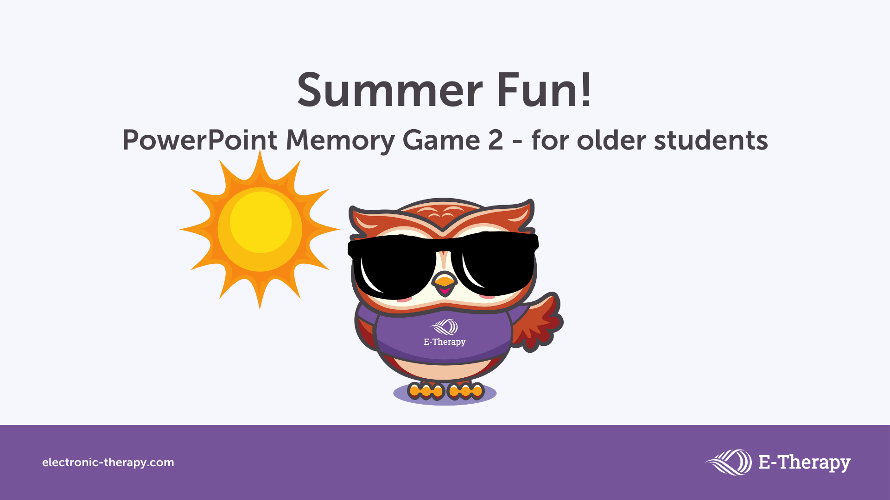

Slide 2
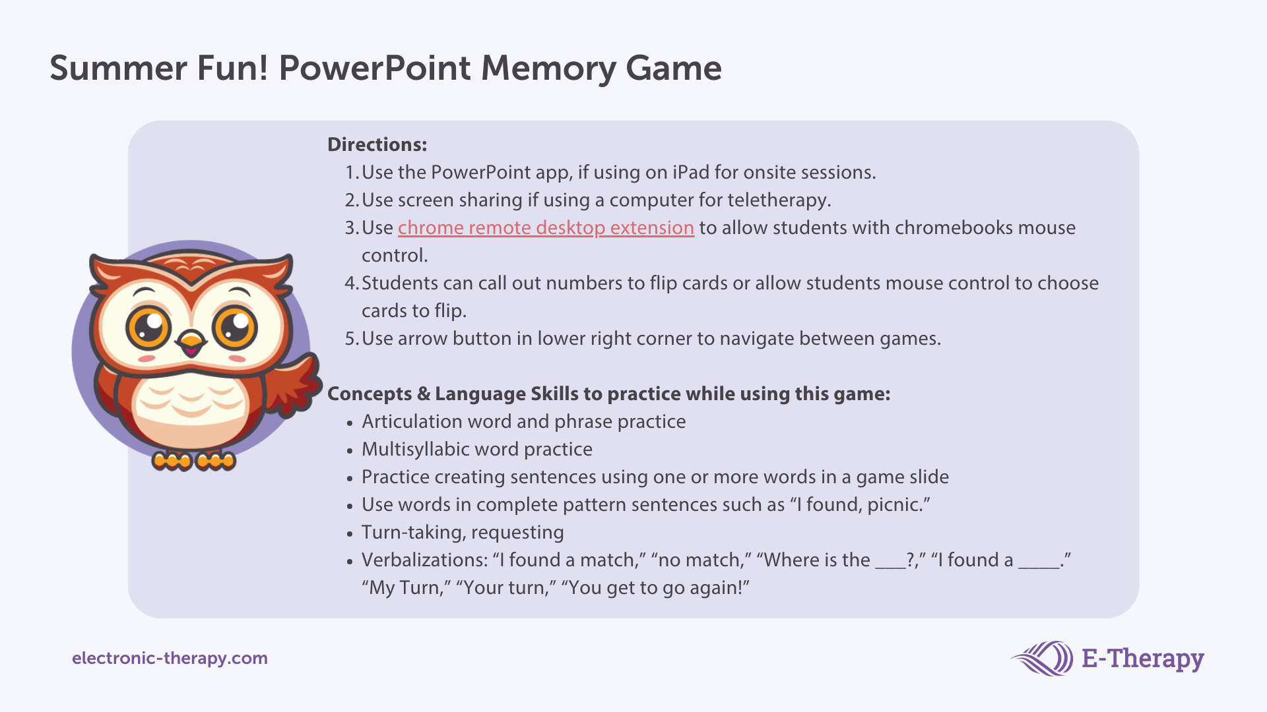

Slide 3

weather
1
relatives
2
relatives
3
travel
4
fireflies
5
fireflies
6
travel
7
lemonade
8
lemonade
9
weather
10

Slide 4
humid
1
humid
2
July
3
August
4
camping
5
June
6
June
7
July
8
camping
9
August
10

Slide 5
vacation
1
vacation
2
swimming
3
bicycle
4
beach
5
swimming
6
beach
7
sunshine
8
sunshine
9
bicycle
10

Slide 6
watermelon
1
picnic
2
mosquitoes
3
ice cream
4
picnic
5
swimsuit
6
ice cream
7
mosquitoes
8
watermelon
9
swimsuit
10

Slide 7
going on vacation
1
air conditioner
2
Fourth of July
3
air conditioner
4
melting popsicle
5
going on vacation
6
melting popsicle
7
Fourth of July
8
fresh fruit
9
fresh fruit
10

Slide 8
lemonade stand
1
thunder and lightening
2
colorful butterflies
3
lemonade stand
4
going fishing
5
thunder and lightening
6
mowing grass
7
mowing grass
8
colorful butterflies
9
going fishing
10

Slide 9


